Slide 1







PROJECT STAKEHOLDER MANAGEMENT
1

Slide 2



Table of content
Stakeholder Engagement Management
Stakeholders & Stakeholder Engagement Overview | 30m
Identify Stakeholders | 20m
Plan Stakeholder Engagement | 20m
Manage Stakeholder Engagement | 20m
Monitor Stakeholder Engagement | 20m
Stakeholder Engagement Management in Agile | 20m
Case study / discussion / assignment | 45m

Slide 3
Course Objectives
Walk through
Project Stakeholder engagement Management processes of PMBoK
Common understanding of
Project Stakeholder Management
Practical Management of
Project Stakeholde
Discuss on Project Stakeholder Management in Agile environment

Slide 4


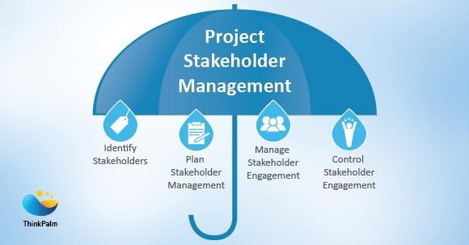
Stakeholders &
Stakeholder Engagement in Project Management
Stakeholders – a person or group of people
Impacts to the project
Impacted by the project
Stakeholder Engagement Management processes:
Identify who are stakeholders
the people, groups, or organizations that could impact or be impacted by the project
Analysis stakeholders’ requirements
Power
Expectations
Interesting level
Plan: what should we do? And how?
to get their engagement at right expectation.
Manage: implement the plan
Monitor: does the plan work? Do we need to change?
Maintain, review their engagement,
Make changes if needed.

Slide 5




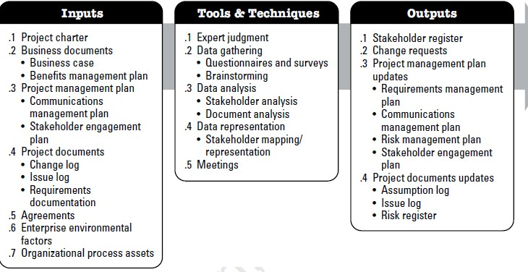


Identify ALL of them
STEP 1: IDENTIFY STAKEHOLDERS
Identify as much as possible of their
Requirement & Expectations
Identify through out the project (regularly)
SH analysis might be sensitive
should be carefully expose to people
ITTO to be used to Identify SH

Slide 6
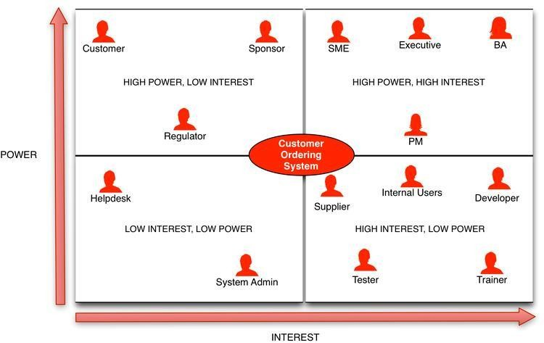
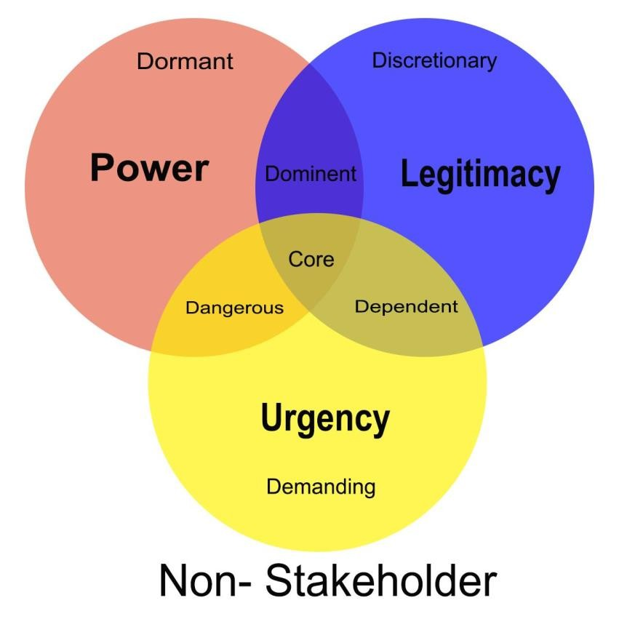
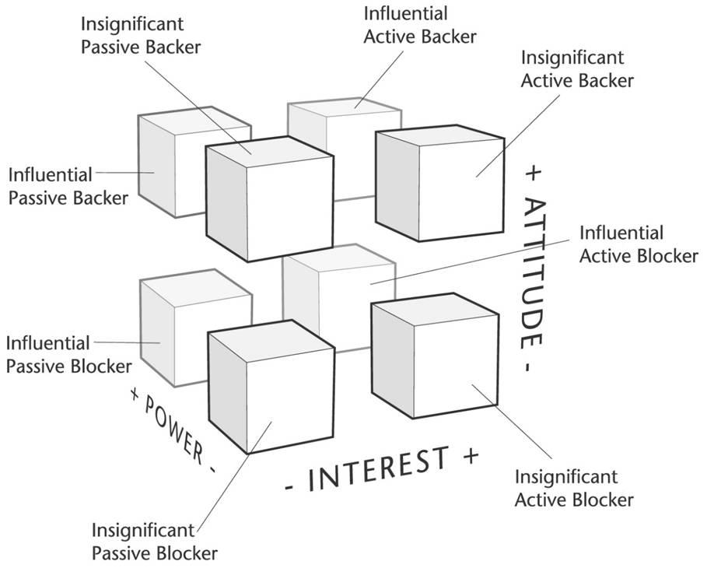
SAMPLE: STAKEHOLDER ANALYSIS

Slide 7
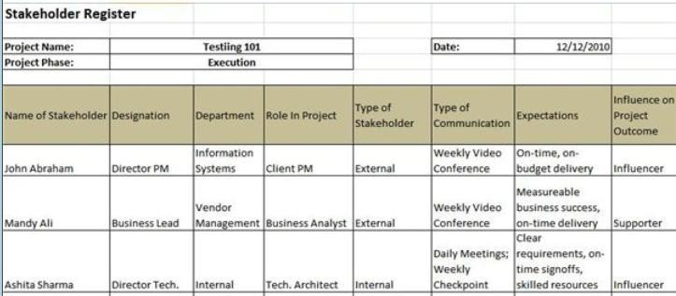
SAMPLE: STAKEHOLDER REGISTER
# | Name | Email | Position | Project role | Main expectation | Impact | Interest | Expertise | Remark
1 | Nguyen Thanh Lam | LamNT@ | CEO | OM | Revenue | Loss Revenue and Reputation

Slide 8


QUESTION
List typical Stakeholders and their Power, Interest, Requirement,
Expectation…
In a project?
In an Agile project?

Slide 9


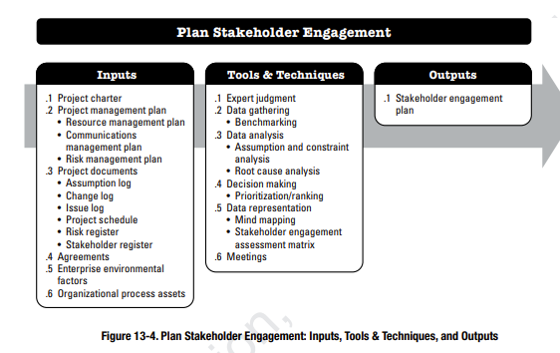

To define actions and strategies for each Stakeholder to move their engagement to desired level
STEP 2: PLAN STAKEHOLDER ENGAGEMENT
MANAGEMENT
Engagement:
productive involvement of stakeholders
in decision making and execution.
ITTO to be used to Plan SH engagement managem
1. assessment matrix
SH analysis might be sensitive
should be carefully expose to people

Slide 10
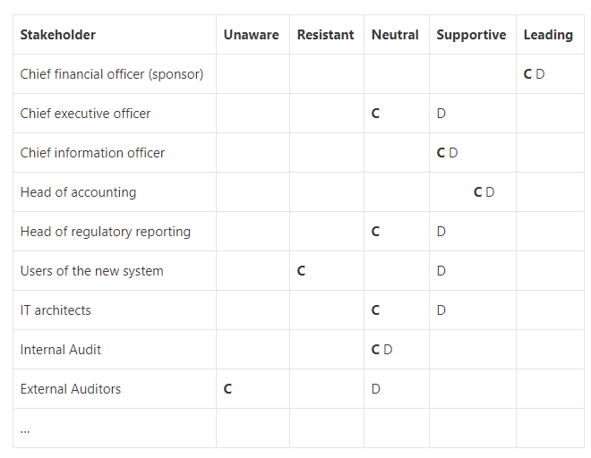
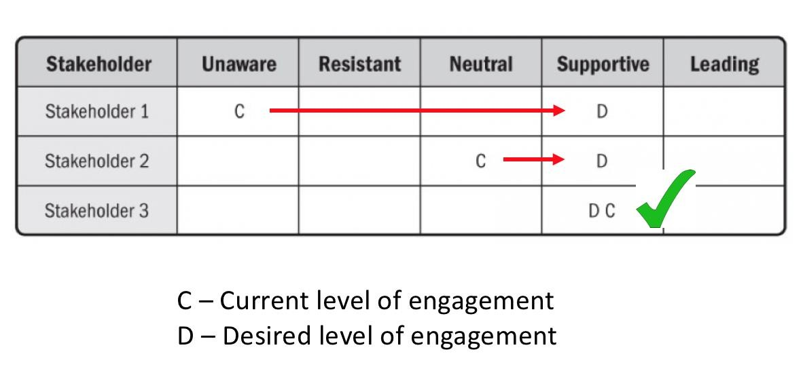
SAMPLE: STAKEHOLDER ASSESSMENT MATRIX
GAP?

Slide 11
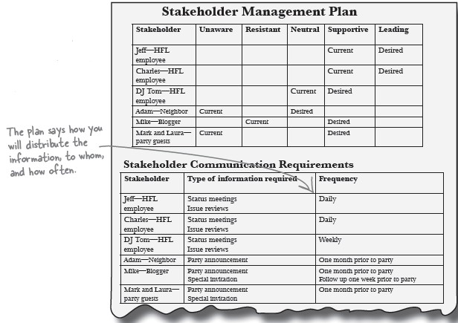
SAMPLE: STAKEHOLDER MANAGEMENT PLAN

Slide 12
QUESTION
In the listed Stakeholders from previous question, please:
Make assumption on Current level of their engagement (brainstorm)
Define Desired level of their engagement and actions to achieve those level?

Slide 13

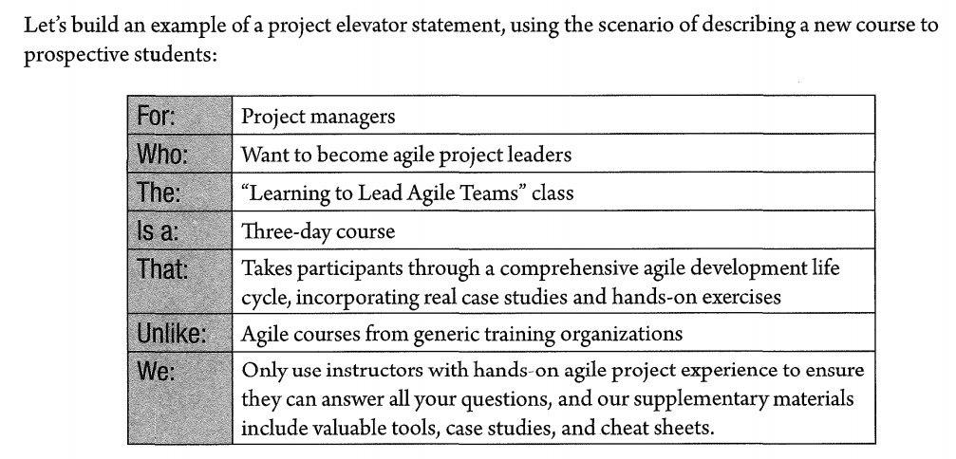
Stakeholder Engagement Plan in Agile
Management Product Owner Agile Coach Members
…
SHARED VISION
AGILE CHARTER
Establish a shared vision to align stakeholders.
This will help to overcoming the semantic gap between what the
customer asks for and how the team interprets that description.

Slide 14

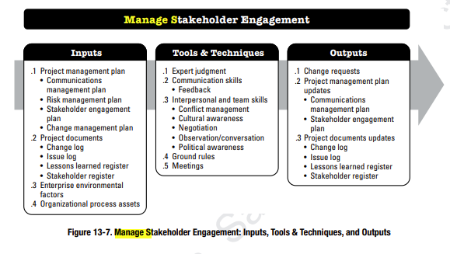
ENGAGEMENT MANAGEMENT
STEP 3: MANAGE STAKEHOLDER
To communicate and work (implement the plan) with stakeholders to meet their needs and expectations, address issues, and foster appropriate stakeholder involvement.
Benefit: to increase support and minimize
resistance from stakeholders.
Perform throughout the project.
Important ITTO
1, Expert judgement
2, Meetings
Early and Frequent

Slide 15
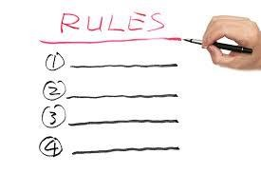

Communication Skills
HIGHTLIGHTED TOOLS & TECHNIQUE
Interpersonal & Team Skills
Ground rules

Slide 16
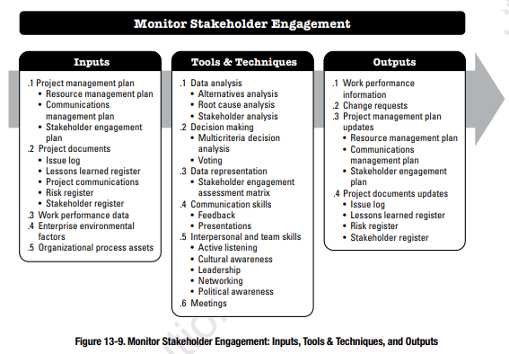

ENGAGEMENT MANAGEMENT
STEP 4: MONITOR STAKEHOLDER
monitoring project stakeholder relationships and tailoring strategies for engaging stakeholders through modification of engagement strategies and plans.
Observe – Analysis - Modify
Benefit: maintains / increases the efficiency and effectiveness of stakeholder engagement activities as the project evolves and its environment changes.
Perform throughout the project.
Need to differentiate from ‘Manage’

Slide 17
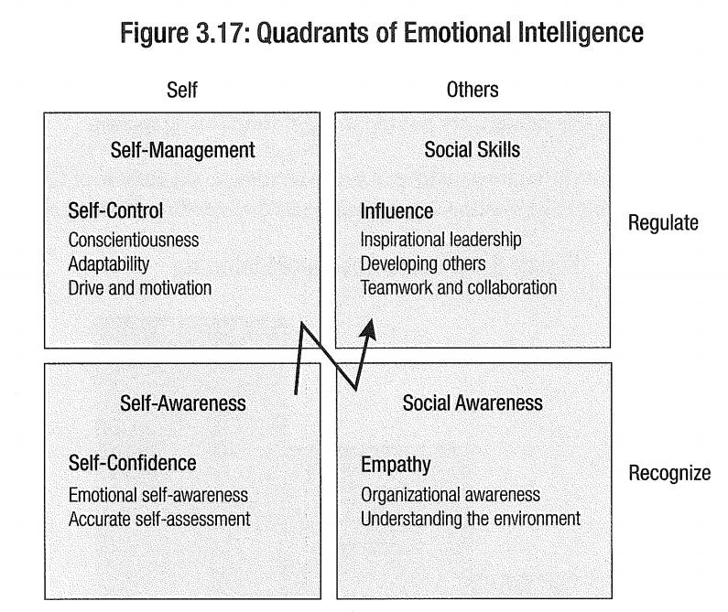
AGILE environment:
Working Collaboratively & Critical Interpersonal Skills
» Emotional intelligence
» Active listening
» Facilitation
» Negotiation
» Conflict resolution
» Participatory decision making

Slide 18
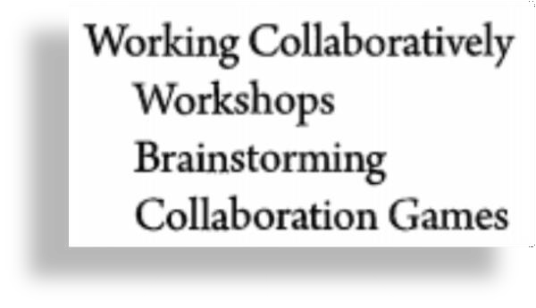
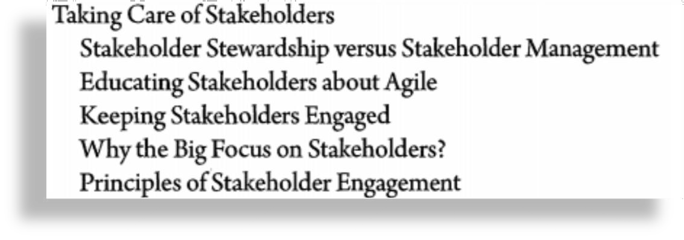
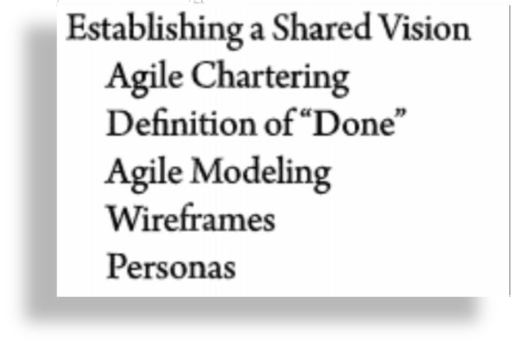
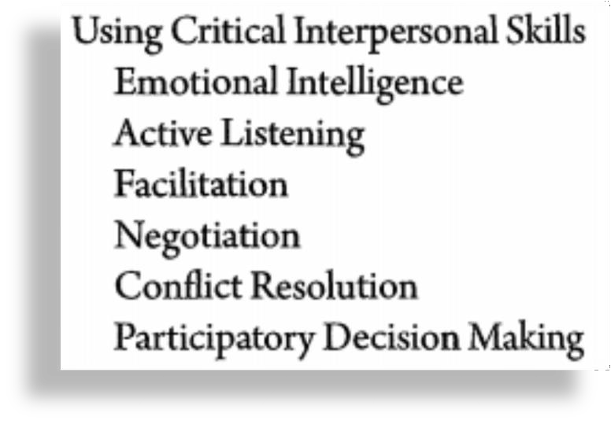
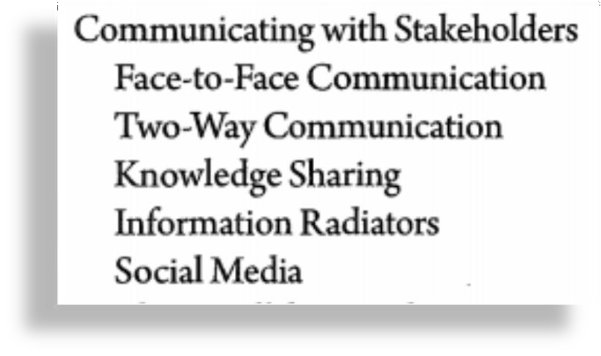
Stakeholders In Agile
AGILE

Slide 19
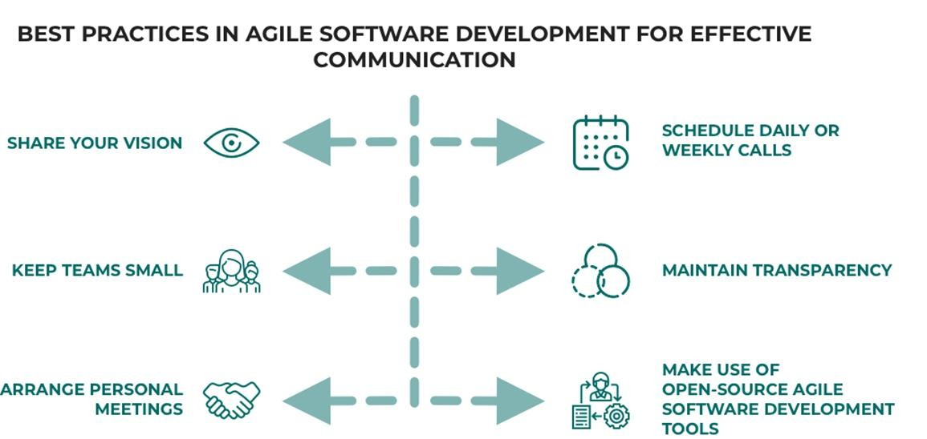

Slide 20
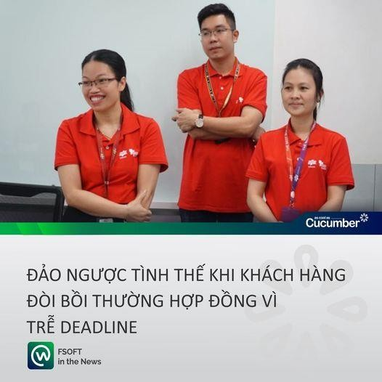
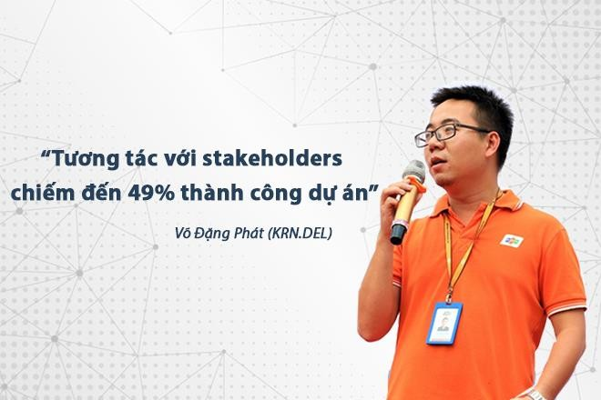
https://cucumber.fsoft.com.vn/vi/du-an-co-the-mat-49-thanh-cong- neu-pm-khong-khac-cot-ghi-tam-dieu-nay/
https://cucumber.fsoft.com.vn/vi/cach-dao-nguoc-tinh-the- khi-khach-hang-doi-boi-thuong-hop-dong-do-tre- deadlinec-tinh-the/

Slide 21

SUMMARY
Identify ↔ Plan ↔ Manage ↔ Monitor

Slide 22
